Slide 1

Biometric Facial Recognition
By Rayan Wali
Period 3, Ms. Lorena

Slide 2
Background
The goal of my project is to create a ASP.NET Web Application that detects faces from an image, with face attributes like gender, age, or pose extracted using Microsoft Cognitive Services on Azure platform. The key goal of the project is to:
Create an ASP.NET Web Application
Create Face API in Microsoft Azure
Load image(s) via Web Application
Detecting faces from an image, and marking them using rectangular framing
Analyzing the gender, age and other features of the face and display on the screen

Slide 3
Items Accomplished
Earlier, I set up the program to detect a face from an image with one face and display its attributes. Now, I added the functionality of the program detecting multiple faces and providing all the attributes for all available/detected faces. After the training process, my program is working very consistently with almost any test image passed in.

Slide 4
The Hierarchy of Classes and Upper-Level Design

Slide 5
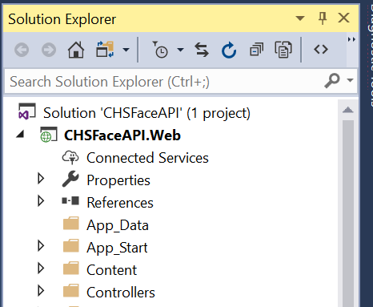
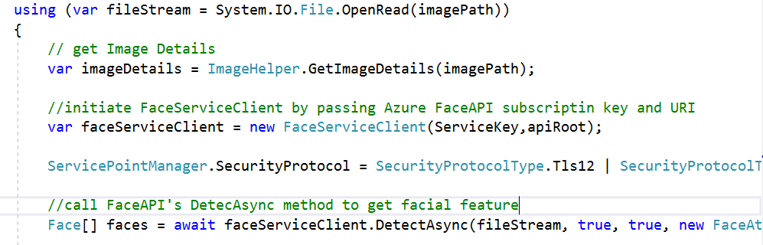

Model-View-Controller Web Application
I created the Controller class that has the method that calls the Azure Face API and passes a loaded file stream:
I created the View page that loads the image and displays the facial attributes:

Slide 6
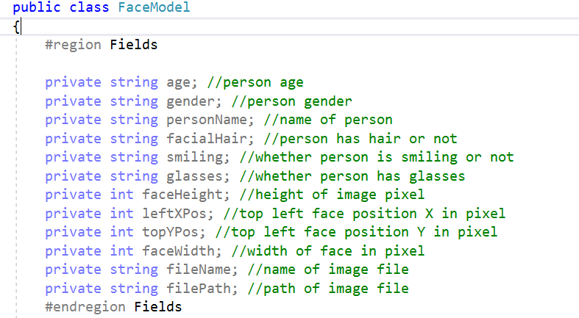
MVC – Face Model Class
FaceModel.cs
The FaceModel class allows capturing of facial attributes by calling the Azure Face API. Once the attributes are populated in the instance of the model class, it is then passed to View to display the data.

Slide 7

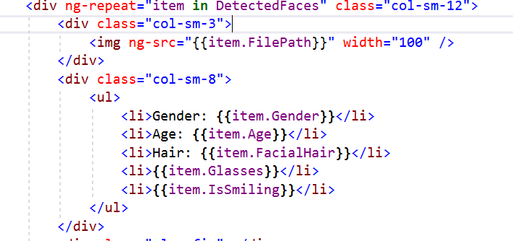
MVC – Face Detection View
FaceDetecton Index.cshtml loops through the collection of the FaceModel instance and displays FaceModel attributes on the screen using HTML.
FaceDetection\Index.cshtml
Collection of FaceModel objects
FaceModel class properties

Slide 8

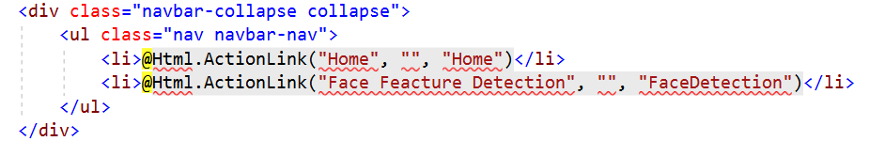
User Interface
Layout.cshtml

Slide 9
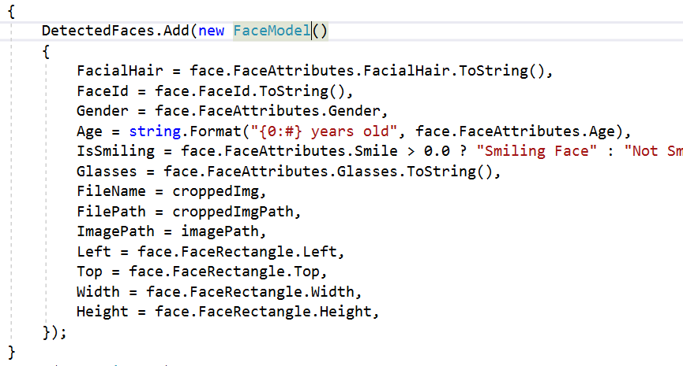
MVC – Face Detection Controller
Calls Face API with the Azure Service Key
Returns a collection of facial features
Loops through the faces collection and load facial features in collection of FaceModel
Face Detection Controller calls Azure Face API and passing image file stream. Then, The Face API detects the faces and returns facial features.
FaceDetectionController.cs

Slide 10
Output and Looks of the ASP.NET Web App…

Slide 11

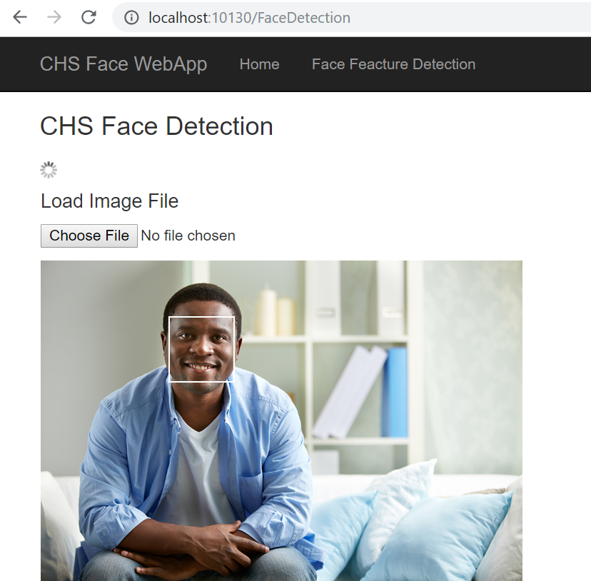

Image File Loader

Slide 12
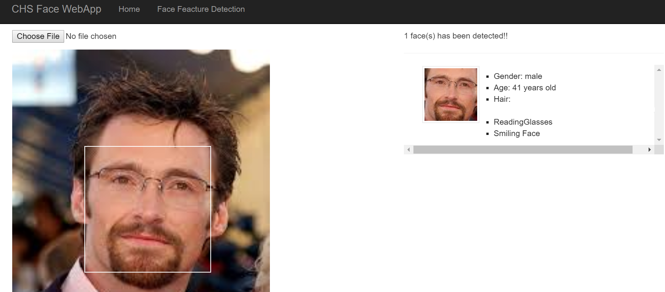
Detecting and Displaying Facial Features From an Image with a Single Face
Facial Features returned by Azure Face API

Slide 13
Detecting and Displaying Facial Features From an Image with Multiple Faces

Slide 14

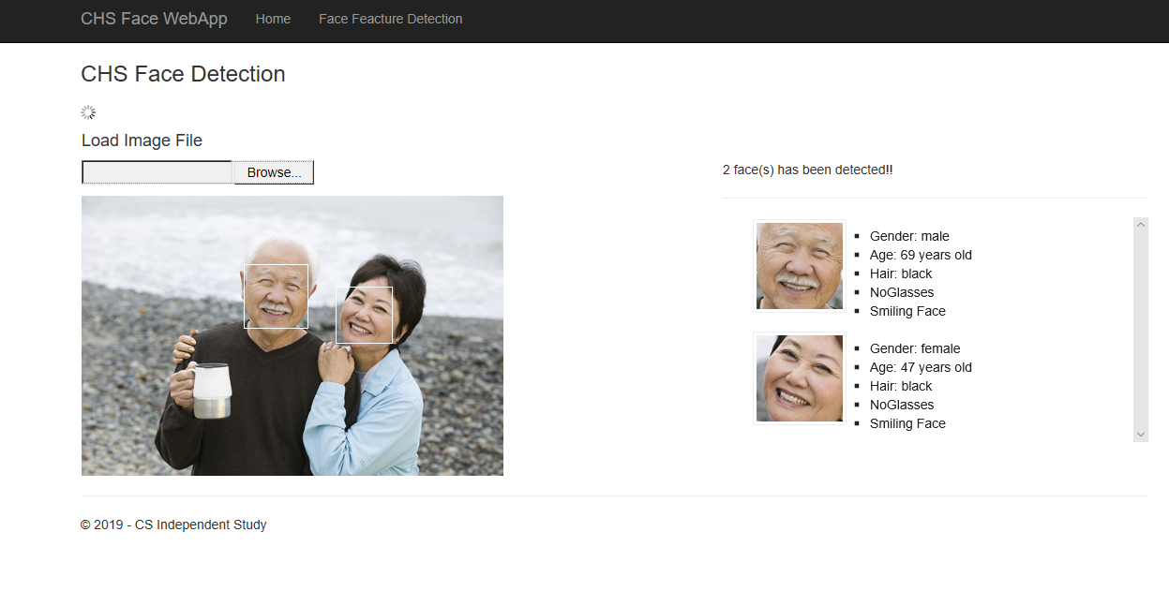
Additional Sample Test Image with Multiple Faces

Slide 15
Additional Learning/Future Considerations
Now that I got a good familiarity with C#, with the ASP.NET web application, and specifically the Face API, I am starting to repeat the same process in Python for additional learning – to learn advanced coding in Python, which I will use Visual Studio for.
So far, I have looked at the functions I will need and how to set up all the classes; for example, that the default cascade for detecting faces is provided by OpenCV, which a set of programming functions for performing computer vision operations, like the project I did in C# this semester.
This will help me get the familiarity with Python that I will need in college and onwards.

Slide 16
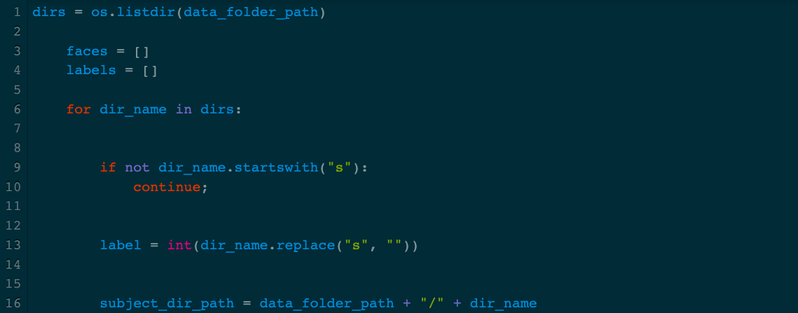
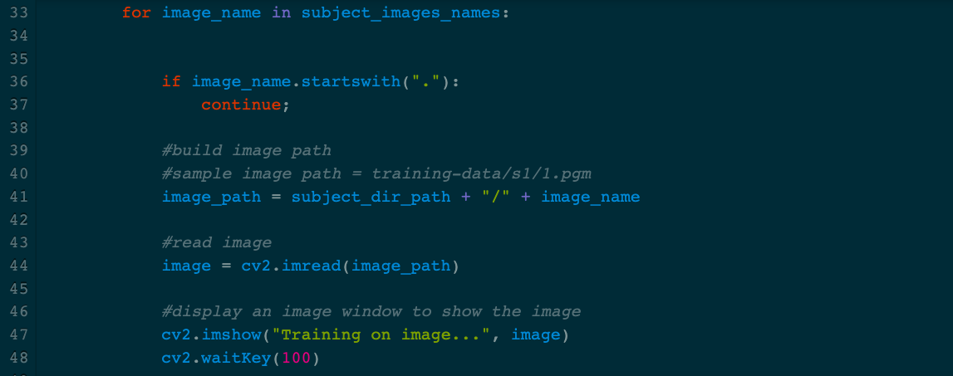
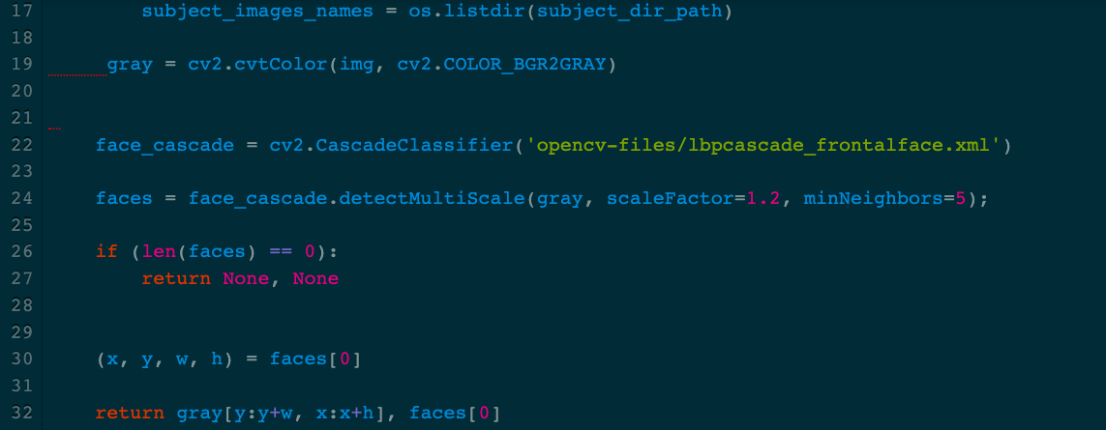
Sample Code in Python (sets up the OpenCV Face Interface and allows the program to take in user input images)

